Slide 1


LATE’s TPD Course 2024-2025
“21st Century Skills and Media Literacy”
(supported by the British Council in Latvia)

Slide 2
Practical Methods to Develop Media Literacy in the EFL Classroom and
Using Authentic Text to Improve and Evaluate EFL Students' Media Literacy and
Language Skills
Joe Horgan
Jelgava Spidola State Gymnasium

Slide 3
Definitions: Media Literacy
  1. Knowledge, understanding, and experience of various media forms. In some definitions the concept includes literacy and numeracy.
  2. Competence in using various media and the ability to think critically about them.
  3. Levels of skill and competence in using media devices. (Oxford Reference)
Media Literacy is a 21st century approach to education. It provides a framework to access, analyze, evaluate, create and participate with messages in a variety of forms — from print to video to the Internet. Media literacy builds an understanding of the role of media in society as well as essential skills of inquiry and self-expression necessary for citizens of a democracy. (Center for Media Literacy)

Slide 4
Definitions
  Media Text: Spoken, print, graphic or electronic communications with a public audience. They often involve numerous people in their construction and are usually shaped by a technology used in their production. Media texts studied in English can be found in newspapers, magazines and on television, film, radio, computer software and the internet. (Government of Western Australia)
  Authentic texts are defined as “written by members of a language and culture group for members of the same language and culture group” (Galloway, 1998, p. 133, as cited in Glisan)

Slide 5
What media literacy is not:
Media 'bashing' is NOT media literacy; however media literacy sometimes involves criticizing the media.
Merely producing media is NOT media literacy, although media literacy should include media production.
Just teaching with digital tools or other mediated content is NOT media literacy; one must also teach about media.
Simply looking for political agendas, stereotypes or misrepresentations is NOT media literacy; there should also be an exploration of the systems making those representations appear "normal."
Media Literacy does NOT mean "don't watch;" it means "watch carefully, think critically.”
(Center for Media Literacy)

Slide 6
State foreign language primary education curriculum standards regarding media literacy:
Pamatskolas posmam sasniedzamie rezultāti: | Learning outcomes for primary education:
VS.9.1.1.1. Apzināti izmanto daudzveidīgas domāšanas stratēģijas (piemēram, nosakot cēloņu un seku sakarības) valodu apguvē un izziņai citās mācību jomās, meklējot un salīdzinot nepieciešamo informāciju dažādās valodās un avotos. | VS.9.1.1.1. Consciously uses diverse thinking strategies (e.g., determining cause-and-effect relationships) in language learning and cognition in other areas of learning, searching for and comparing necessary information in different languages ​​and sources.
VS.9.1.1.4. Atbilstoši uzvedības un saskarsmes normām pavēsta, ka saprot dzirdēto/lasīto (piemēram, formulējot sarunas biedra teikto saviem vārdiem), bet, ja nesaprot teikto, lūdz sarunu partneri to paskaidrot vai precizēt. | VS.9.1.1.4. In accordance with the norms of behavior and communication, states that they understands what they have heard/read (for example, by formulating what the interlocutor said in theirown words), but if they does not understand what was said, asks the interlocutor to explain or clarify it.
VS.9.1.1.10. Patstāvīgi izvēlas tekstus virtuālajā vidē par sev interesējošām tēmām, izvērtē iegūtās informācijas ticamību, atsaucas uz informācijas avotu. Sazinās un sadarbojas, izmantojot dažādus rīkus un paņēmienus informācijas iegūšanai, mācībām, izklaidei. | VS.9.1.1.10. Independently selects texts in the virtual environment on topics of interest to them, evaluates the reliability of the information obtained, refers to the source of information. Communicates and collaborates using various tools and techniques for obtaining information, learning, and entertainment.
VS.9.2.1.2. Klausās vai lasa tekstus (piemēram, diskusijas, ziņu ierakstus, vēstules, brošūras) par dažādām tēmām, salīdzina tekstu veidus un izmanto iegūto informāciju mācību vajadzībām. | VS.9.2.1.2 Listens to or reads texts (e.g., discussions, news articles, letters, brochures) on a variety of topics, compares text types, and uses the information gained for learning purposes.
VS.9.2.1.4. Izvērtē informācijas ticamību tīmeklī, piemēram, ziņu portālos un sociālajos tīklos, un pārbauda avotus. Atbildīgi apmainās ar informāciju (ieraksti emuārā, komentāri forumā). | VS.9.2.1.4 Evaluates the reliability of information on the web, such as news portals and social networks, and verifies sources. Shares information responsibly (blog posts, forum comments).

Slide 7
Standards regarding evaluation of information:
VS.9.1.1.1. Consciously uses diverse thinking strategies (e.g., determining cause-and-effect relationships) in language learning and cognition in other areas of learning, searching for and comparing necessary information in different languages ​​and sources.
VS.9.1.1.10. Independently selects texts in the virtual environment on topics of interest to them, evaluates the reliability of the information obtained, refers to the source of information. Communicates and collaborates using various tools and techniques for obtaining information, learning, and entertainment.
VS.9.2.1.4 Evaluates the reliability of information on the web, such as news portals and social networks, and verifies sources. Shares information responsibly (blog posts, forum comments).
Kahoot presentation about criteria to evaluate information: https://create.kahoot.it/share/trustworthy-sources/ef5887e4-1911-4234-9a8e-6022d59eac99

Slide 8
For each of the “checklist items” on the left, decide whether it is evidence of a high-quality source to use in your project and why for each.
Sign of a high quality source? | Yes | No | Why?
The author provides their information sources (references)
The author makes bold or extreme claims about the topic
The author or website is attempting to sell a product or service
The web address (URL) includes .gov or .edu
The information is at least 15 years old
The author uses anecdotal evidence
The author attacks other people or organizations
The overall tone of the article is neutral and professional
The information has been “peer reviewed” by other experts
The author is interested in promoting themself
The author is well qualified to write about the topic
The information can be found elsewhere in other sources

Slide 9

Evaluating sources of information
When evaluating a source and deciding whether it is reliable enough to use in your research, here are a few “good signs” and “bad signs” as to whether it should be trusted. REMEMBER: just because one or more of these signs is true, it doesn’t mean that the source you have found is automatically trustworthy. You must look at the source as a whole, take into consideration multiple aspects, and only then conclude whether there are more good signs or bad signs overall.

Slide 10
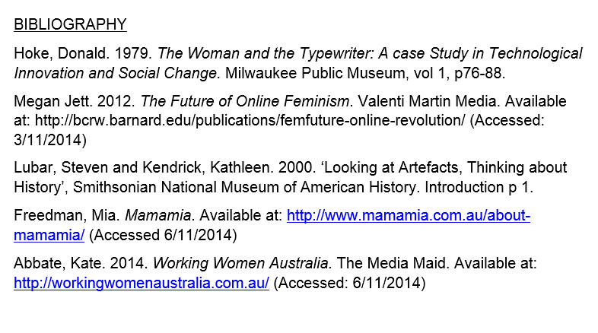
The author provides their information sources (references)
This is a good sign because the author is not afraid of you checking the sources yourselves. This also shows that the information actually came from somewhere. However, you cannot automatically assume that the sources are real, reliable, or used correctly unless you check them yourself. It is also important to make sure that they are not misquoting the original information, either accidentally or in a manipulative way.

Slide 11
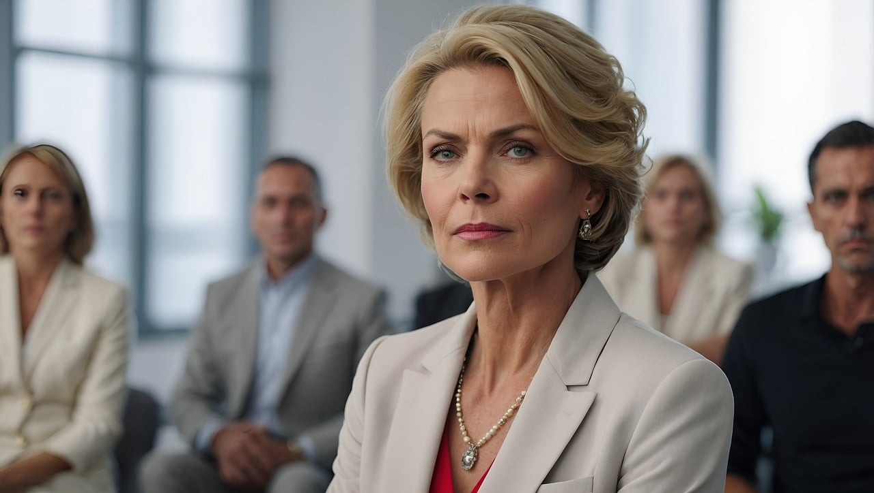
The author is well qualified to talk about the topic
See what you can find out about the author of the information. Just because they might have a doctoral degree in economics doesn’t mean that they are an expert in medicine or public health. On the same note, just because they are a doctor doesn’t necessarily mean that all other doctors agree with them. Use a search engine and see what you can find out about the reputation of the author and the website on which their work is published.

Slide 12

The overall tone of the article is neutral and professional
Of course, it is possible to write all kinds of nonsense in a neutral and professional style. However, experts usually write in a neutral and professional tone as doing otherwise can harm their reputation (which is very important to them) and make them seem overly emotional.

Slide 13

The web address (URL) ends with .gov (government institution)
Although you shouldn’t just automatically trust everything that a government says, governments provide a lot of funding for independent scientific research and are generally interested in informing their citizens with quality information. This, of course, depends on the government — the government of North Korea might have some strange information when it comes to human rights, whereas the government of Russia has a different idea about the history of Ukraine than most of the world does.

Slide 14

The web address (URL) ends with .edu (educational institution)
Educational institutions also fund high quality independent research and are freer of pressure to find results that fit a certain narrative than research funded by private companies — a study on the environmental impact of plastic bottles funded by the EU or the University of Latvia is likely to have more trustworthy results than a study funded by a company that makes plastic bottles. Make sure that what you are reading is not student work that has been uploaded, however.

Slide 15

The author or website is attempting to sell a product or service related to the topic
Some “experts” will write about how terrible and profit-driven the mainstream healthcare and medicine industry is, but at the same time are trying to sell “alternative products” such as herbal and homeopathic remedies. Although some of their criticisms might be legitimate, they have a financial interest in trying to get people to trust mainstream medicine less and use their own products more.

Slide 16
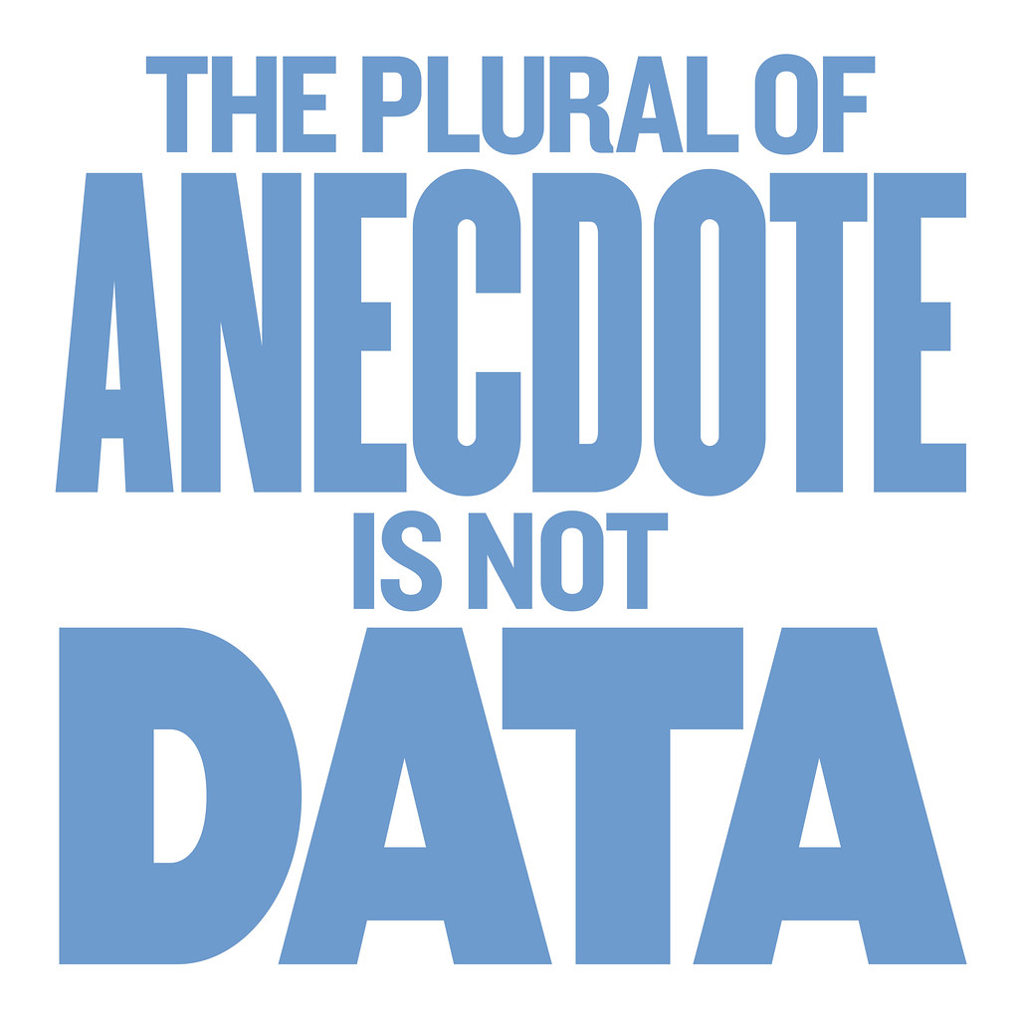
The author heavily uses anecdotal evidence
An example of this would be “my grandfather smoked a full pack of cigarettes every day and lived until he was 110, which is why I think that smoking isn’t actually bad”. Although it may be true that your grandfather smoked and lived a very long time, is this true of most people who smoke? Is one person’s experience, or even a few people’s, really strong evidence that smoking isn’t bad for you?

Slide 17
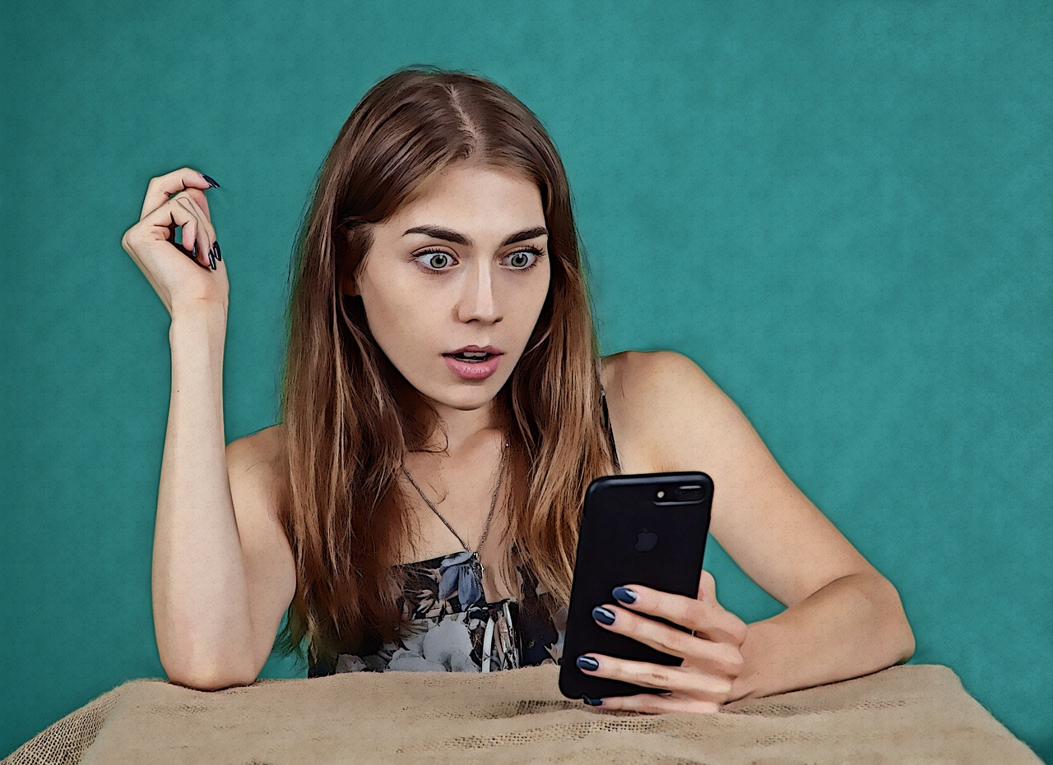
The author makes bold or extreme claims about the topic
Shocking headlines and extreme claims make it more likely that you will open a page or article, which is good for the website’s owner since more clicks means more money from advertisements. However, if something sounds too crazy to be real, your first instinct should be to pause and see if you can find that same information from other trustworthy sources as well. If you cannot, then it is a very bad sign that the information can be relied on.

Slide 18
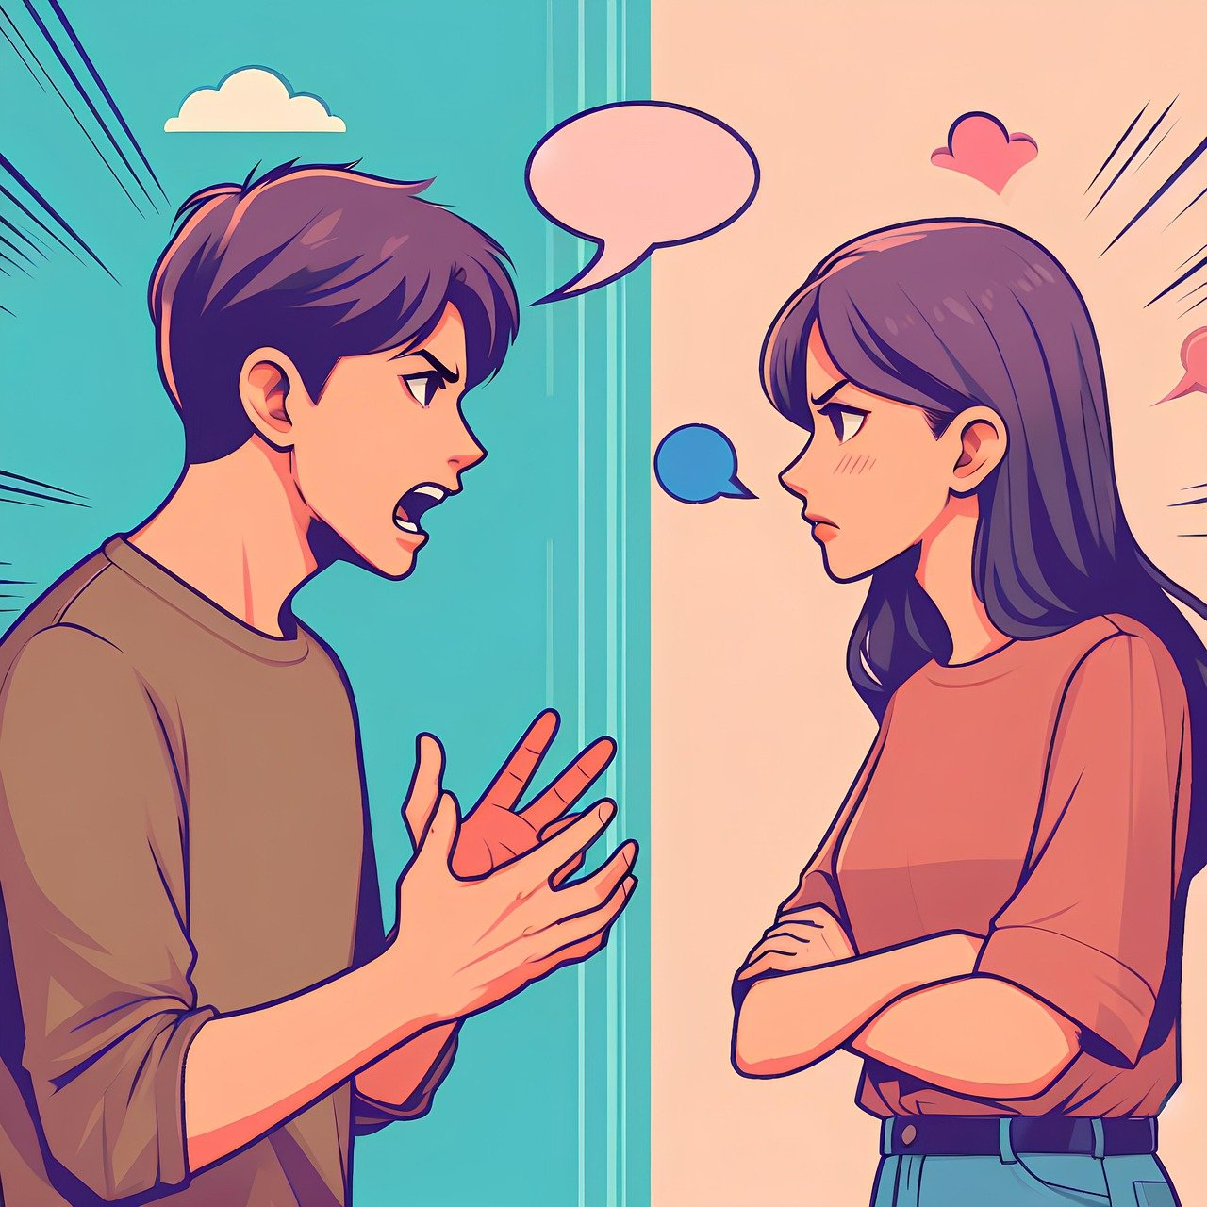
The author attacks other people or organizations
If you notice that a source is attacking a person as much as or even more than they are attacking the points or arguments that that person is making, it is a sign that they might not actually have a good counter-argument. This is called “ad hominem” and is a common logical fallacy.

Slide 19

The author is interested in promoting themselves
Respectable authors, especially scientists, are extremely careful to focus on their work and not themselves. They even go so far as using the passive voice when they write or call themselves “the author of this paper” instead of using “I”. The more an author seems self-important and focuses on their supposedly impressive achievements and background, the less likely it is that this is actually a respected and credible expert in their field.

Slide 20

The information cannot be found anywhere else, or only in other suspicious sources
If there is some information that you find and really want to use in your research but cannot find it mentioned anywhere else, this might be a red flag that the information is not actually credible. However, you must be careful — just because there are many websites you can find that have “evidence” that the world is flat, it does not mean that this is credible information.

Slide 21
VS.9.1.1.4. In accordance with the norms of behavior and communication, states that they understands what they have heard/read (for example, by formulating what the interlocutor said in theirown words), but if they does not understand what was said, asks the interlocutor to explain or clarify it.
Task example:
According to Cambridge Dictionary, a norm is “an accepted standard or a way of behaving or doing things that most people agree with”
Together with a partner, come up with a list of at least five norms (expected behaviors) people should follow when communicating online.
Then, as a class, we will come up with a list of norms that we should follow while communicating online.

Slide 22
Norms that people should follow when communicating online:
Be polite
Respect one another and their differences
Listen/read carefully
Use clear language
Constructively criticize
Stay on topic
Follow language conventions
Imagine you are communicating face-to-face
Remember that what you write could be there permanently
Respect the privacy of others
Use appropriate register
Be compassionate
Criticize someone’s opinions without making personal attacks

Slide 23
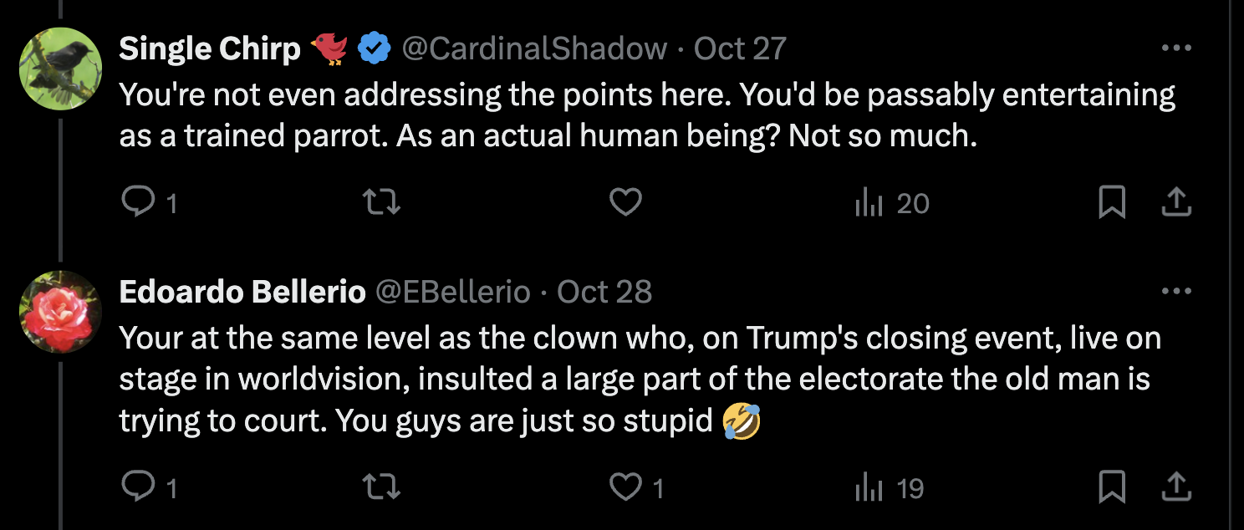
Task: On social media or in the comments of a news story, find an interaction which doesn’t follow the norms agreed on as a class. Rewrite the text so that it follows the norms.
Original version: | Improved version:
 | Single Chirp: “Unfortunately, it seems as if you still have not addressed the specific points of the discussion. Could you please do so?” Edoardo Bellerio: “This situation reminds me of how Donald Trump made insulting remarks to voters when on stage and on live TV – I should think that we can do better here!”

Slide 24
State foreign language secondary education curriculum standards regarding media literacy:
Vispārējās izglītības sasniedzamie rezultāti: | Learning outcomes for secondary education:
VS.A.2.1.1. Pamana un analizē sociolingvistiskos elementus (t. sk. humoru, ironiju un sarkasmu) svešvalodā dažādos tekstos, filmās, videomateriālos un salīdzina tos ar dzimto valodu. | VS.A.2.1.1. Notices and analyzes sociolinguistic elements (including humor, irony, and sarcasm) in a foreign language in various texts, films, and video materials and compares them with the native language.
VS.A.2.1.2. Analizē neverbālos saziņas elementus videomateriālos, lai noteiktu runātāja attieksmi. | VS.A.2.1.2. Analyzes nonverbal communication elements in video materials to determine the speaker's attitude.
VS.A.2.2.1. Kritiski izmanto daudzveidīgas teksta uztveres stratēģijas savu mērķu sasniegšanai (piemēram, tulko tekstu, vērtē teksta autora lomu un viedokli). | VS.A.2.2.1. Critically uses a variety of text comprehension strategies to achieve their goals (e.g., translates text, evaluates the role and opinion of the author of the text).
VS.A.2.2.3. Analizē un kritiski izvērtē dažādu tekstu (t. sk. runāto) informācijas kvalitāti un avotu ticamību, lai atbildīgi izmantotu to savu tekstu veidošanā svešvalodā. | VS.A.2.2.3. Analyzes and critically evaluates the quality of information and the reliability of sources in various texts (including spoken texts) in order to use them responsibly in creating their own texts in a foreign language.
VS.A.2.2.4. Nosaka un analizē tekstveides līdzekļus (piemēram, salīdzina atsauces uz avotiem zinātniskajā un populārzinātniskajā stilā), kas veido teksta funkcionālo stilu attiecīgajā svešvalodā. | VS.A.2.2.4. Determines and analyzes the means of text formation (for example, compares references to sources in scientific and popular science style) that form the functional style of the text in the relevant foreign language.
VS.A.1.1.2. Analizē saziņas situācijā izmantotos valodas līdzekļus, lai noteiktu un aprakstītu tās sociopolitisko kontekstu. | VS.A.1.1.2. Analyzes the language used in a communication situation to determine and describe its sociopolitical context.
VS.A.1.2.1. Mērķtiecīgi meklē informāciju svešvalodā, kritiski to izvērtē pēc noteiktiem kritērijiem, lai izmantotu savā radošajā un pētniecības darbībā. | VS.A.1.2.1. Purposefully searches for information in a foreign language, critically evaluates it according to certain criteria in order to use it in their creative and research activities.
VS.A.1.2.2. Izmantojot svešvalodas zināšanas, salīdzina dažādus viedokļus par pētāmo objektu, apraksta sava pētījuma rezultātus, formulē secinājumus un loģiski tos pamato. | VS.A.1.2.2. Using knowledge of a foreign language, compares different opinions about the object of study, describes the results of their research, formulates conclusions and logically justifies them.
VS.A.1.2.6. Sagatavojas debatēm, formulē argumentus par un pret, savāc pierādījumus un piedalās debatēs starptautiskā kontekstā. | VS.A.1.2.6 Prepares for debates, formulates arguments for and against, collects evidence, and participates in debates in an international context.

Slide 25
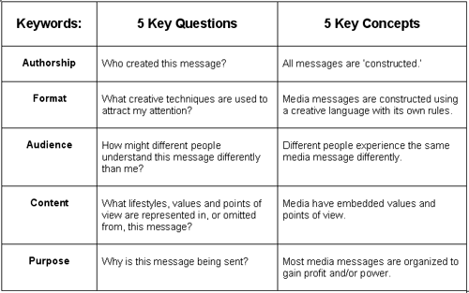
The 5 key questions of media literacy
Framework created by the Center for Media Literacy in the United States
Can be used to evaluate any type of media content
Includes main questions and guiding questions that can be used in a number of different ways

Slide 26
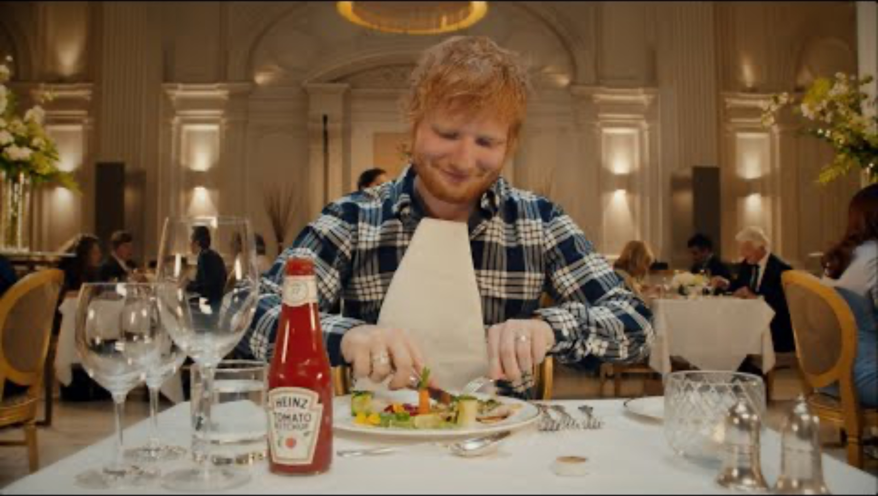
1: Who created this message?
What kind of “text” is it? (genre)
What are the various elements (building blocks) that make up the whole?
How similar or different is it to others of the same genre?
Which technologies are used in its creation?
What choices were made that might have been made differently?
How many people did it take to create this message? What are their various jobs?
https://www.youtube.com/watch?v=keOaQm6RpBg

Slide 27
1: Who created this message?
Question | Answer
What kind of “text” is it? (genre) | This is a television commercial for food that has been uploaded to YouTube (need to be as specific as possible in order to answer later questions)
What are the various elements (building blocks) that make up the whole? | There is video depicting a situation inside a restaurant, music that seeems to fit the mood of the situation, sound effects including a dramatic heartbeat and silverware clanging, and text showing the logos of the brand and the musician. On YouTube, there are is a description and the ability for users to comment.
How similar or different is it to others of the same genre? | Most food ads simply show the food being eaten and say good things about it whereas this one is far more implicit by showing that Ed wants to use it even in an expensive fancy restaurant. It is also portrayed as an “idea he had” instead of an actual commercial.
Which technologies are used in its creation? | A professional video camera was used to capture the scenes, and professional lighting equipment also was likely used. Professional audio equipment as well as a computer and professional editing software were also used. To upload it to Youtube, a device with an internet connection was needed.
What choices were made that might have been made differently? | The advertisement could have been made in a more “traditional” way telling about the ketchup and its price. They could also have set the ad in a place where it would be more likely that someone would have ketchup with them.
How many people did it take to create this message? What are their various jobs? | It took at least a filmographer to operate the camera, lighting operators, audio engineers to record the audio, the actors, and a team of people to edit the video and upload it to the internet (and send it to television networks)

Slide 28
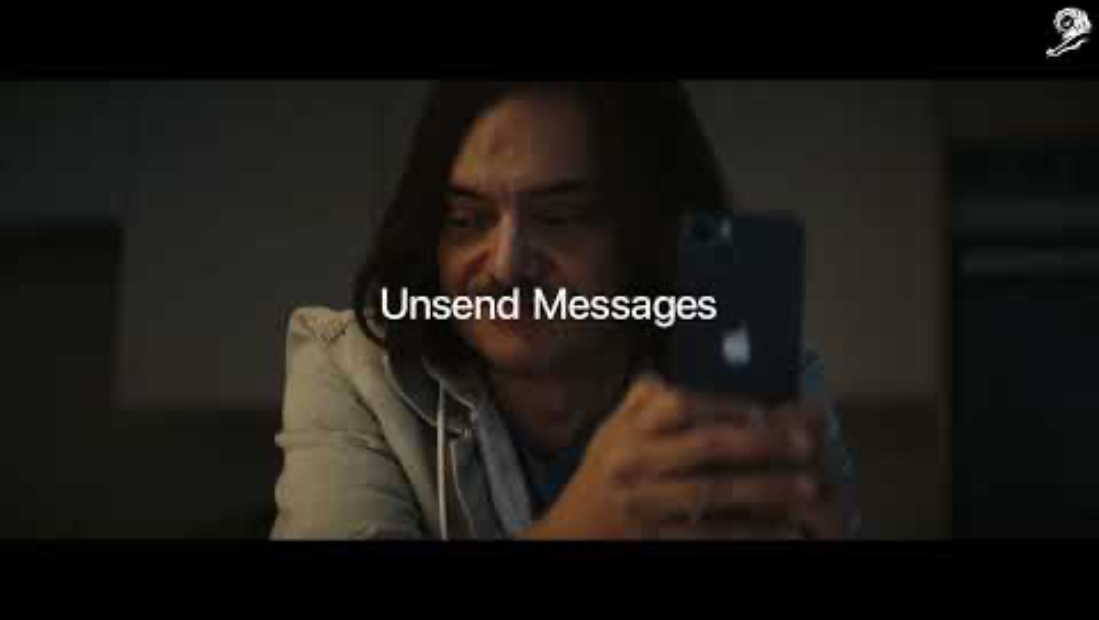
2. What creative techniques are used to attract my attention?
What do you notice… (about the way the message is constructed)
  Colours? Shapes? Size?
  Sounds, Words? Music? Silence?
  Props, sets, clothing?
  Movement? Composition? Lighting?
  Where is the camera? What is the viewpoint?
  How is the story told visually? What are people doing? Are there any symbols? Visual metaphors? What’s the emotional appeal? Persuasive devices used?
  What makes it seem “real?”
https://www.youtube.com/watch?v=lW6fCFYcV_0

Slide 29
2. What creative techniques are used to attract attention?
Question | Answer
How are colours used? Shapes? Size? | The colors are mostly neutral tone to show that the main character is a modern and everday person. The only color that stands out is the color of the lizard which helps draw attention.
How is sound used? Words? Silence? | There is a significant amount of silence at the beginning of the video to help create a somber mood when it seems like the lizard is dead. The words of the SMS conversation seem quite realistic, as if there were ones that could actually be written such as “thanks, you’re a lifesaver.” The sound is used effectively at the moment the lizard wakes up to draw attention to the importance of the moment, and the “pop” effect helps the audience remember the phone’s feature. The music progresses from sounding sad, like the beginning of the advertisement, to sounding upbeat like the end, and the lyrics “I can’t believe I survived” sync with the moment the lizard wakes up and seems to ”come back alive.”
How are props used? Setting? Clothing? | The clothing of the main character is very casual, such as his hoodie, to help make him seem more relateable to a majority of the people watching. The props help make the set seem like a realistic modern apartment .
How is movement used? Composition? Lighting? | The main movement of the video is when the lizard suddenly wakes up, which helps draw attention to this moment — before this, there is very little movement. The lighting is made to seem natural and realistic but draws attention to the main character and the lizard.
Does it seem real? | Although this specific situation might not happen regularly, most people have been in a situation where they were trusted to do something and made a huge mistake. This portrayal seems similar to the fears we have in our head about what could go wrong.

Slide 30

3. How might different people understand this message differently?
Have you ever experienced anything like this in your life?
How close is this portrayal to your experience?
What did you learn from this media text?
What did you learn about yourself yourself from experiencing from experiencing the media text?
What did you learn from other people’s response? From their experience of life?
How many other interpretations could there be? How could we hear about them?
Are other viewpoints just as valid as mine? How can you explain the different responses?

Slide 31
3. How might different people understand this message differently?
Question | Answer
How might different people understand this message differently? | While the intended idea of the advertisement seemed to have been that their products will allow busy mothers to spend less time cleaning and spend more time with their kids, many women might understand the message to be that their true “place” is at home cleaning and taking care of kids, not developing a career. After checking on Google, this indeed was the case, and many people complained to the company who later apologized for the advertisement.
Have you ever experienced anything like this in your life? | Although I have not experienced any kind of sexism in my life that I have noticed, I have spent time with my mother cleaning when I was younger which was a fun experience and is likely what the company wanted to portray when creating this ad without thinking of the other ways that the message could be interpreted.
What did you learn about yourself yourself from experiencing from experiencing the media text? | From experiencing this advertisement and analyzing it, I understand that I am lucky to not have to deal with the kind of sexist attitudes that many women have to. I understand also that when creating media, I should also be very careful to think of all of the different ways it can be interpreted by people with different life experience from my own.

Slide 32
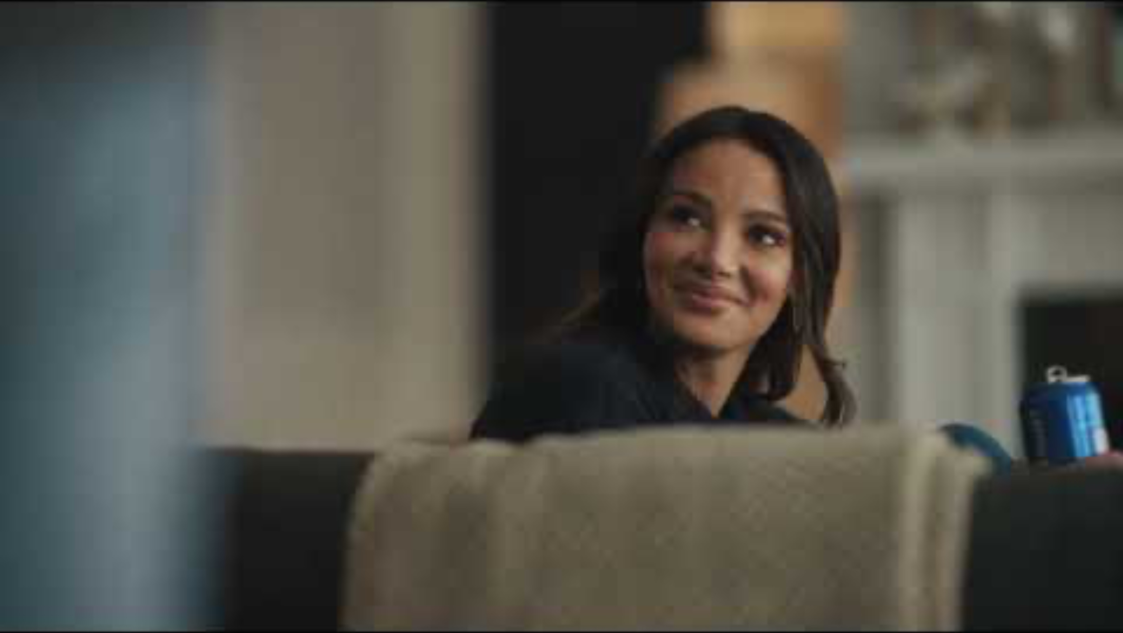
4. What lifestyles, values and points of view are represented in, or omitted from, this message?
What kinds of behaviours / consequences are depicted?
What type of person is the reader / watcher / listener invited to identify with?
What questions come to mind as you watch / read / listen?
What ideas or values are being “sold” to us in this message?
What economic or political ideas are communicated in the message?
What is the overall worldview of the message?
What ideas or perspectives are left out? How would you find what’s missing?
https://www.youtube.com/watch?v=azCNwGnxq0s

Slide 33
4. What lifestyles, values and points of view are represented in, or omitted from, this message?
Question | Answer
What kinds of behaviours / consequences are depicted? | The main behavior portrayed is opening a beer with your partner in order to deal with the boredom of having to wait a long time on customer service. A positive consequence is shown, as the main character seems to have much more fun after opening the beer.
What type of person is the reader / watcher / listener invited to identify with? | The main character who is lying on the couch at the beginning of the advertisement is the one we are invited to identify with, as this situation of having to wait a long time on a customer service one is a common one that many people can identify with.
What ideas or values are being “sold” to us in this message? | The main idea being “sold” is that beer is an excellent way to help people have a better time. Although the woman’s partner could have invited her to start dancing in a silly way without the beer, it is implied that the beer is the key to this happening as he goes to the refridgerator first and taking out the cans before doing so.
What economic or political ideas are communicated in the message? | Aside from the idea about the beer, the commercial portrays a middle-class couple who is spending free time together in what appears to be a modern home. They do not appear to have children and only a dog, which is a more normal situation for people their age than it would have been 20-30 years ago.
What ideas or perspectives are left out? | The main thing that is “left out” is the worrying fact that they seem to be drinking beer in the early afternoon as if it is a totally normal occurance, which could be a potential sign of aolcohol dependency.

Slide 34
5. Why is this message being sent?
Who’s in control of the creation and transmission of this message?
Why are they sending it? How do you know? Who are they sending it to? How do you know?
What’s being sold in this message? What’s being told? Who profits from this message?
Who is served by or benefits from the message – the public? – private interests? – individuals? – institutions?
Who pays for it?
https://www.youtube.com/watch?v=keOaQm6RpBg

Slide 35
4. What lifestyles, values and points of view are represented in, or omitted from, this message?
Question | Answer
Who’s in control of the creation and transmission of this message? | The main parties in control of the advertisement’s creation are the advertising firm that has been hired, the Kraft Heinz Foods Company, and Ed Sheeran’s team, as they all have to agree on the content that is shown. The transmission of the advertisement is controleld mostly by the TV networks that show it, as it is their decision whether or not they will, and the government agency that regulates ads, as it must follow all regulations. Since it is uploaded on YouTube, it must follow all rules of the platform as well.
Who is the target audience? | Since Ed Sheeran mostly appeals to people from the Gen Z, Millenial, and Gen X generations, and since the ad is quite negative towards the upper class, the target audience is likely lower to middle class English speakers ages 18-50.
Who is served by or benefits from the message – the public? – private interests? – individuals? – institutions? | The Heinz ketchup company obviously benefits from this content, as they hope that people will go and buy their ketchup after watching it and that this will increase their sales and their profits. Ed Sheeran also benefits from this message as it adds to the “average person” public person he carefully creates with his music (despite being a multi-millionaire). The government might benefit as it could lead to increased value added tax revenue. The network benefits as the company pays for the advertising time.
Who pays for it? | The Kraft Heinz Foods Company most likely pays for this content as they are the ones who have commissioned its creation.

Slide 36
Other useful media literacy resources
A disinformation game about fake news (lv, en, ru)
A disinformation game about COVID-19 (lv, en, ru, de, fr, ua)
A Kahoot game about disinforamtion (lv)
A fake profile quiz (en)
A website about logical fallaies with a poster (lv, en, ru, de, fr)
A video about media ethics (en)
A video about media ownership (en)
A list of common advertising techniques(lv, en)
A Kahoot game about common advertising techniques(lv, en)

