Slide 1


LATE’s TPD Course 2024-2025
“21st Century Skills and Media Literacy”
(supported by the British Council in Latvia)

Slide 2
Cultivating Creativity by Turning EFL Students into Media Content Producers
Joe Horgan
Jelgava Spidola State Gymnasium

Slide 3
Definitions: Media Literacy
  1. Knowledge, understanding, and experience of various media forms. In some definitions the concept includes literacy and numeracy.
  2. Competence in using various media and the ability to think critically about them.
  3. Levels of skill and competence in using media devices. (Oxford Reference)
Media Literacy is a 21st century approach to education. It provides a framework to access, analyze, evaluate, create and participate with messages in a variety of forms — from print to video to the Internet. Media literacy builds an understanding of the role of media in society as well as essential skills of inquiry and self-expression necessary for citizens of a democracy. (Center for Media Literacy)

Slide 4
What media literacy is not:
Media 'bashing' is NOT media literacy, however media literacy sometimes involves criticizing the media.
Merely producing media is NOT media literacy, although media literacy should include media production.
Just teaching with digital tools or other mediated content is NOT media literacy; one must also teach about media.
Simply looking for political agendas, stereotypes or misrepresentations is NOT media literacy; there should also be an exploration of the systems making those representations appear "normal."
Media Literacy does NOT mean "don't watch;" it means "watch carefully, think critically.”
(Center for Media Literacy)

Slide 5
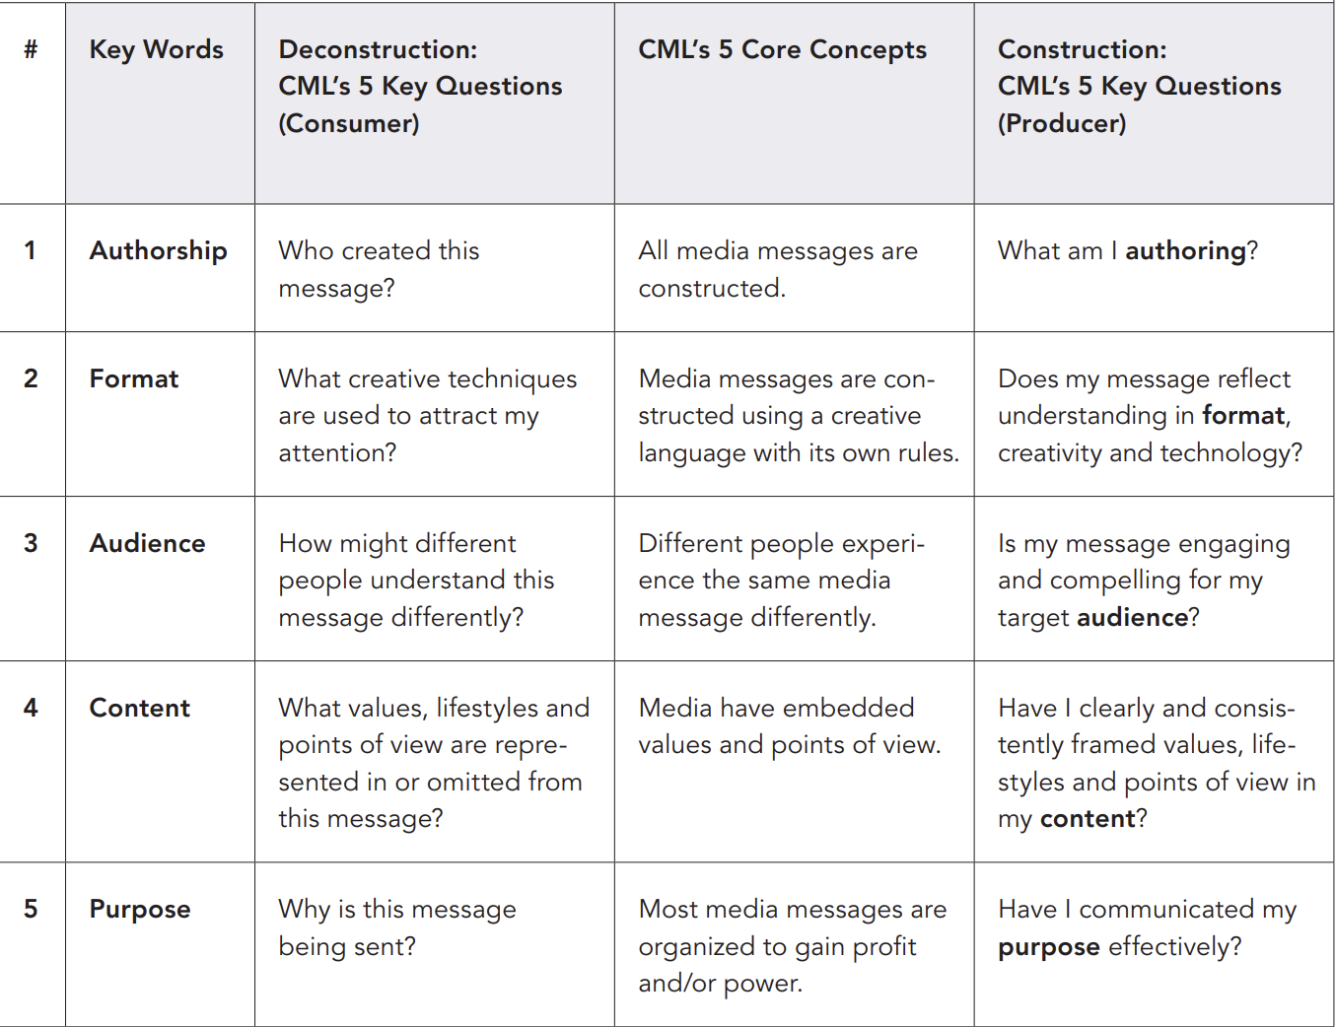
CML’s Questions/TIPS (Q/TIPS) © 2002—2007 Center for Media Literacy www.medialit.org

Slide 6
1. What am I authoring?
What kind of “text” genre am I creating?
What various elements (building blocks) make up the whole?
How similar or different is it to others of the same genre?
Which technologies am I using to create? What will my medium be?
How would my construction be different in a different medium?
What are my choices? What choices might I make differently?
Have others contributed to this construction? How should they be credited?
Have I respected copyright, trademarks or other intellectual property that I may have used?

Slide 7
2. Does my message reflect understanding in format, creativity and technology?
What do I want people to notice…or not…(about the way I am constructing my message)?
What technologies am I using? How is my message structure affected?
What techniques stand out the most? Color and shapes? Sound? Silence? Dialogue or Narration? Movement? Composition? Lighting? Texture? Scent?
How am I telling the story? Do I know the storytelling conventions available to me? What storytelling conventions am I using?
When does my message take place? What is the setting or timing of my message? What impact might the setting or timing of my message have on other choices I make?
What visual or verbal, musical or visual symbols or metaphors am I using?
What emotional appeal am I using?
What persuasive devices am I employing? Am I being ethical?
What factual information am I presenting? Are my facts and information accurate? How do I know?
Does my message seem “real?” Why?

Slide 8
3. Is my message engaging and compelling for my target audience?
Who is the target audience for my message?
What do I know about this person or people? What are some important characteristics about them I should know?
How wide an audience do I want to appeal to? Or how narrow?
Have I respected the need for privacy or confidentiality on the part of my audience?
Have I taken into consideration the appropriateness of my message for special or vulnerable audiences, such as very young children or youth or those disabled?
How might my audience interpret my message and respond to it?
What effect might I anticipate my message having on my audience? Positive, negative, neutral?
Why should my audience care about my message?

Slide 9
4. Have I clearly and consistently framed values, lifestyles and points of view in my content?
What is my main message?
How am I supporting my main message? What information am I including? What am I leaving out? Why?
Who or what do I invite my audience to identify with through my message? What lifestyles, values and points of view are overt? What are implied?
Have I represented other voices or social groups? Are these representations nuanced or are they stereotypical?
What might the opposition to my message say? Have I treated my opposition with respect?
Have I made appropriate disclosures about conflicts of interest or assumptions?
Have I considered the needs of the “whole” person that I’m relating the message to? If not, are my reasons ethical?
Does my message convey real-life behaviors or consequences? If not, why not?
What is the overall worldview depicted in my message?

Slide 10
5. Have I communicated my purpose effectively?
What is my intent? Whose needs am I trying to satisfy with my message?
Am I primarily entertaining, persuading, informing, or encouraging action and participation as the form of my message?
Who is paying for this message to be constructed and sent? Should I disclose this underwriting for any reason?
Do I want my audience to feel, think or do anything specific as a result of engaging with my message?
How is the audience served by my message? How do I profit or benefit? How does the audience profit by or benefit from my message?
Who wins? Who loses? Who decides?
What economic decisions may have influenced my message and how I constructed or transmitted it?
Have I considered ethical, social and/or legal constraints on achieving my purpose?

Slide 11
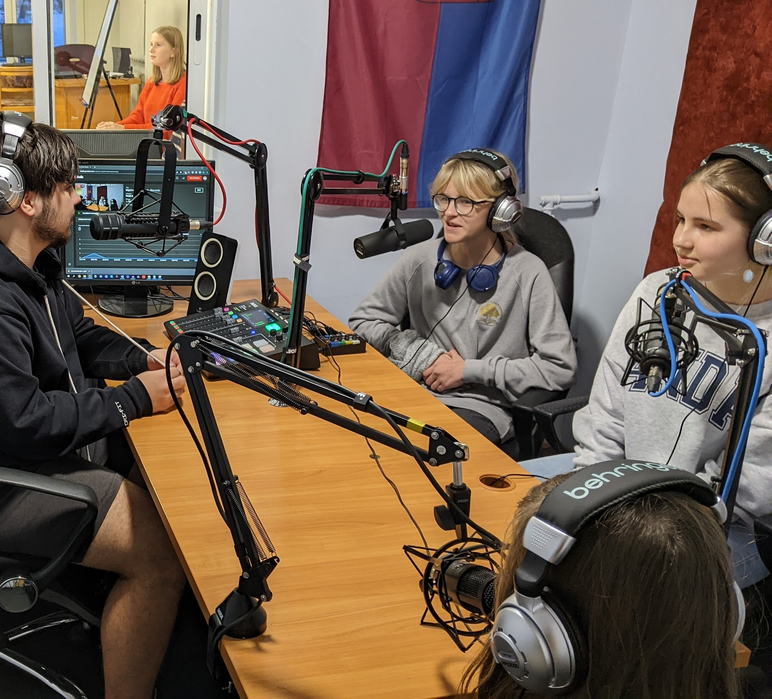
Podcasts
Modern form of media that students are familiar with
Essentially audio-only
Requires 0 budget
Can be used with essentially any content
Opportunities for interdisciplinary projects

Slide 12
Learning outcomes from 7th grade program
Ziņas
Savu attieksmi var paust gan verbāli, gan neverbāli atbilstoši angļu valodas saziņas normām. (V.Li.1.1.)
Sarunājoties, lasot, caurskatot interneta avotus, var iegūt dažāda veida informāciju savu tekstu veidošanai. (V.Li.2.2.)
Prasmes
Izvēlas piemērotus kritērijus vajadzīgās informācijas meklēšanai un atlasīšanai (tai skaitā virtuālajā vidē). (VS.9.1.1.1.; VS.9.1.1.10.)
Izmanto angļu valodu un ievēro saziņas normas, organizējot sadarbību ar klasesbiedriem. (VS.9.1.1.4.; VS.9.1.1.9.)
Prot atrast ticamus avotus, balstoties uz dotajiem kritērijiem. (VS.9.2.1.4.)
Veido savu tekstu, balstoties uz doto shēmu, paraugu, plānu. (VS.9.2.1.6.)
Izvērtē sava teksta kvalitāti un izlabo skolotāja vai klasesbiedru norādītās kļūdas. (VS.9.2.1.8.)

Slide 13
Learning outcomes from 7th grade program
Komplekss sasniedzamais rezultāts
• Meklē un salīdzina informāciju dažādos avotos. (VS.9.1.1.1.)
Stāsta par apkārtējo pasauli, savām interesēm, nākotnes nodomiem, ceļojumiem, kultūras pasākumiem. (VS.9.1.1.2.)
Patstāvīgi izvēlas tekstus virtuālajā vidē par sev interesējošām tēmām. (VS.9.1.1.10.)
Izvērtē informācijas ticamību internetā, piemēram, ziņu portālos un sociālajos tīklos. (VS.9.2.1.4.)
Izmanto dažādus tekstus un citus avotus savas valodas sistēmas attīstīšanai. (VS.9.3.1.1.)
Apspriež sabiedrībā aktuālas tēmas, veido diskusijas, audio/video ierakstus. (VS.9.2.1.1.)
Uzņemas atbildību par savas runas un rakstu pratības pilnveidi; izmanto mācīšanās stratēģijas atbilstoši saziņas situācijai un mācību mērķiem. (VS.9.2.1.8.)
Apkopo vairākus tekstus un tos radoši izmanto sava teksta veidošanā, ievērojot autortiesības, un to publisko; atbild uz jautājumiem (=VS.9.2.1.7.)

Slide 14
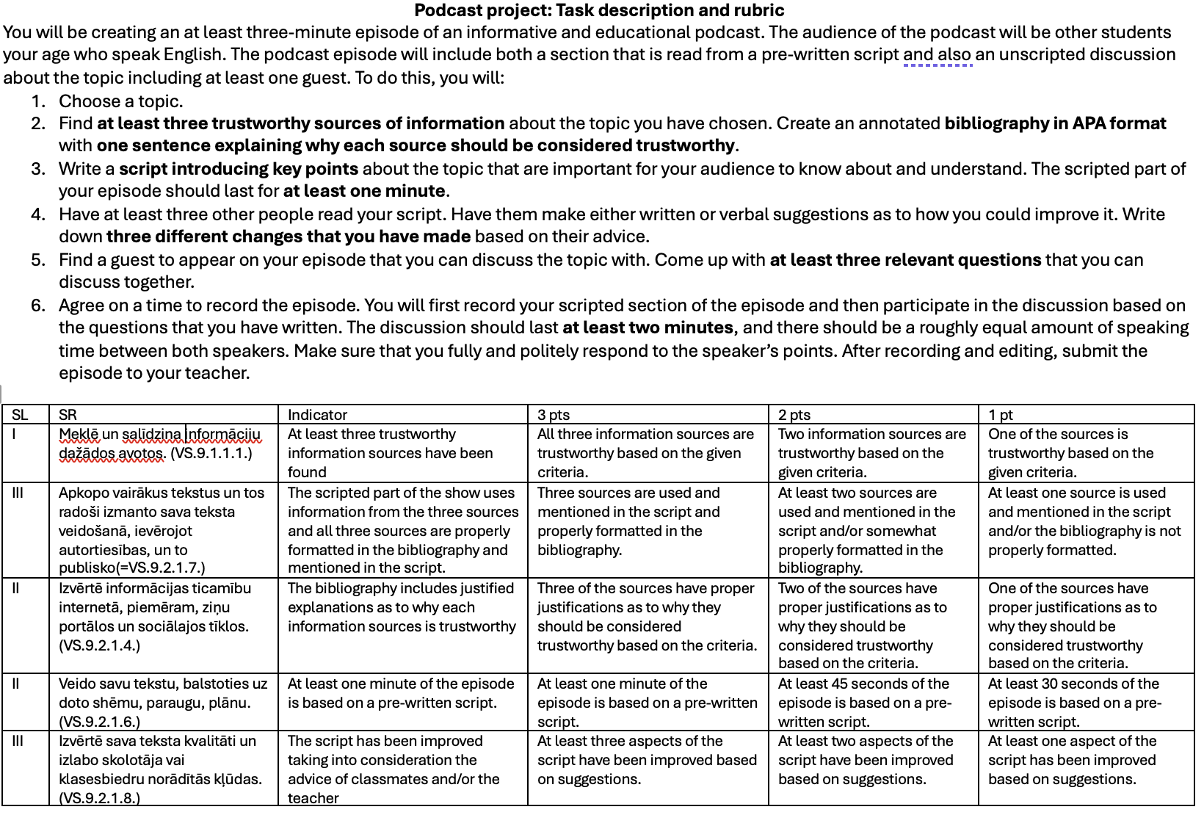

Slide 15
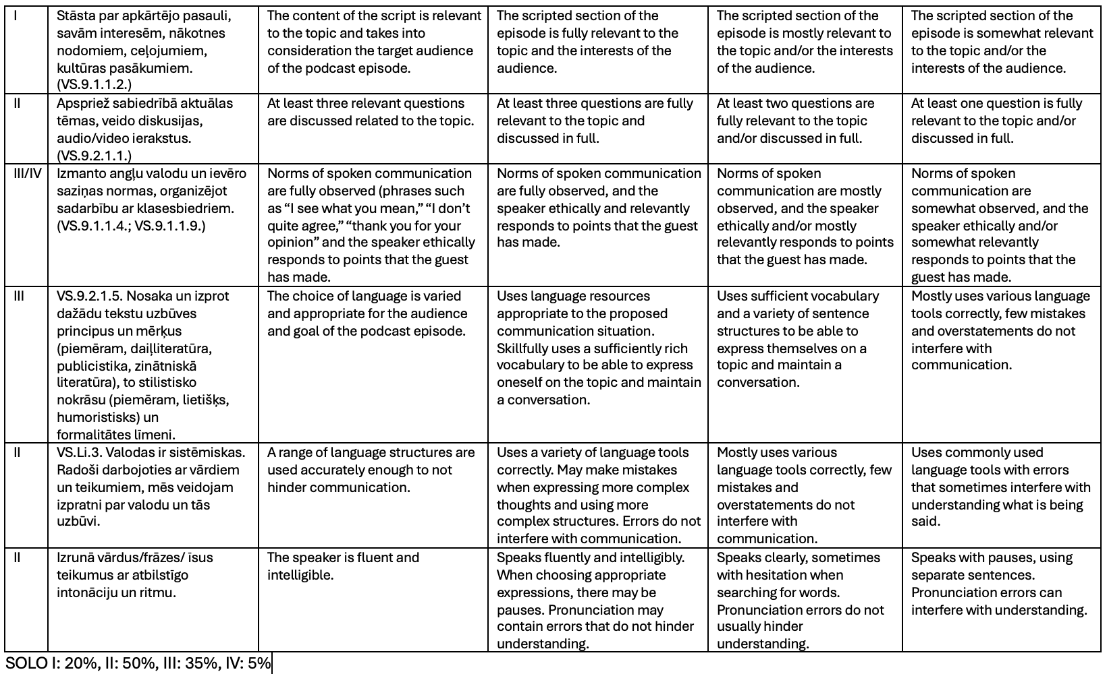

Slide 16
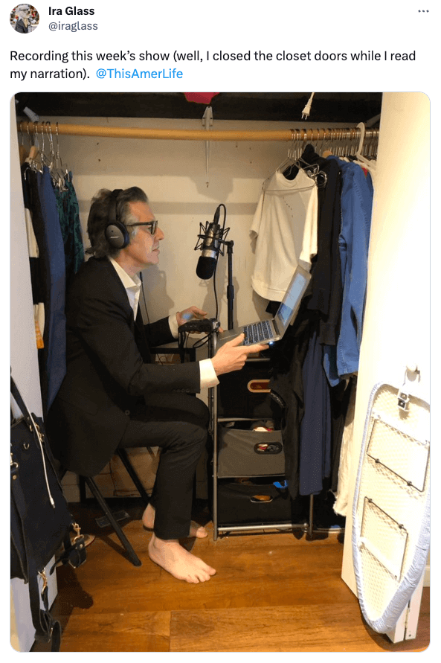
Recording
Microphones (attached to computer, phone microphone, etc)
Location, location, location (quiet, no echo/background noise)
If at first you don’t succeed, try, try again

Slide 17
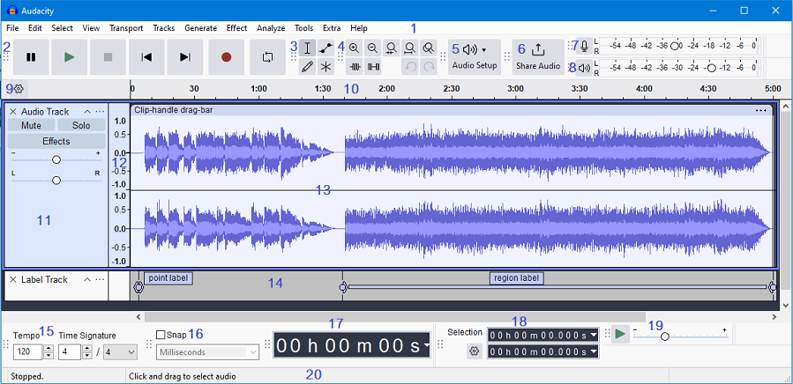
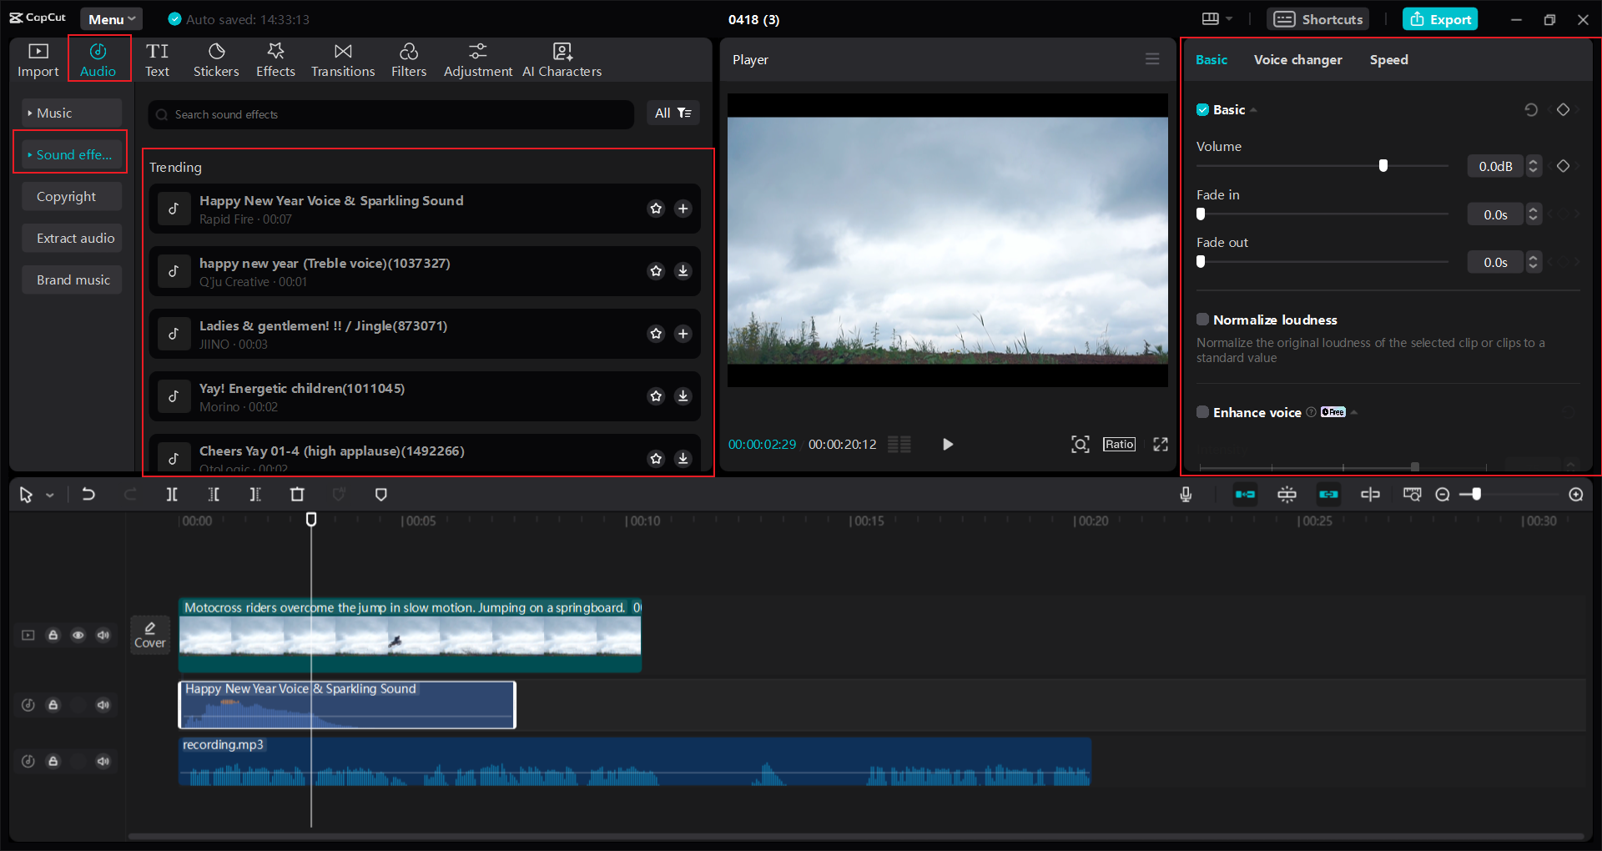
Editing
Audacity (FOSS, can download on any computer from your students’ lifetime)
Capcut, others
Good opportunity to work with IT

Slide 18
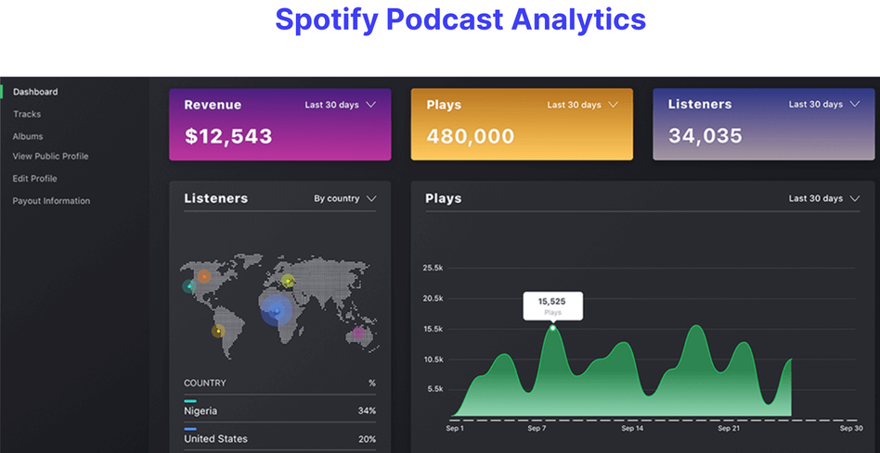
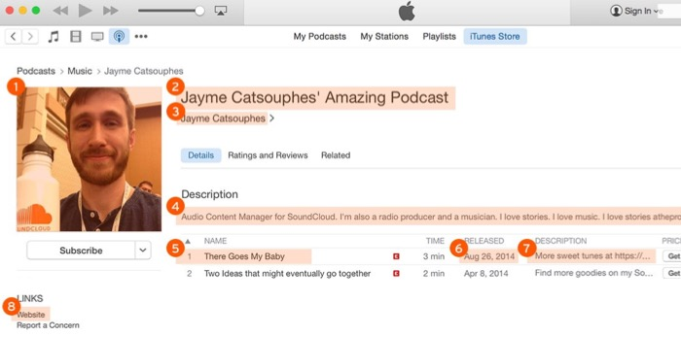
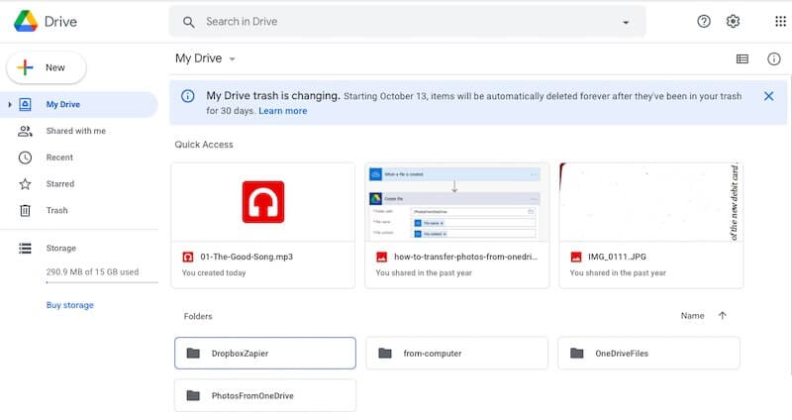
Publishing
Spotify
Soundcloud
Google Drive

Slide 19
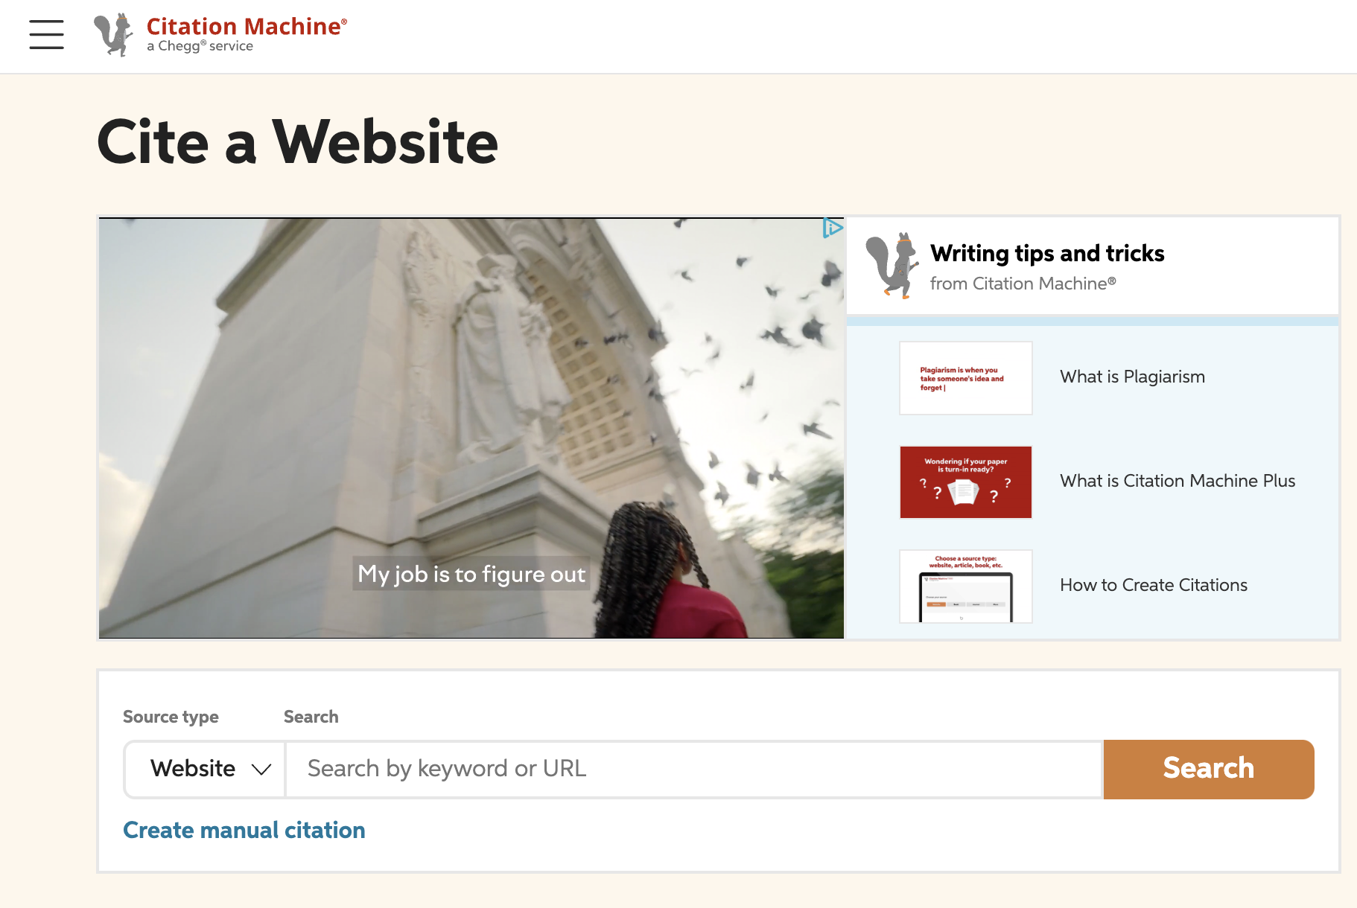
Citing Sources
APA, MLA, ect
Citation Machine

Slide 20
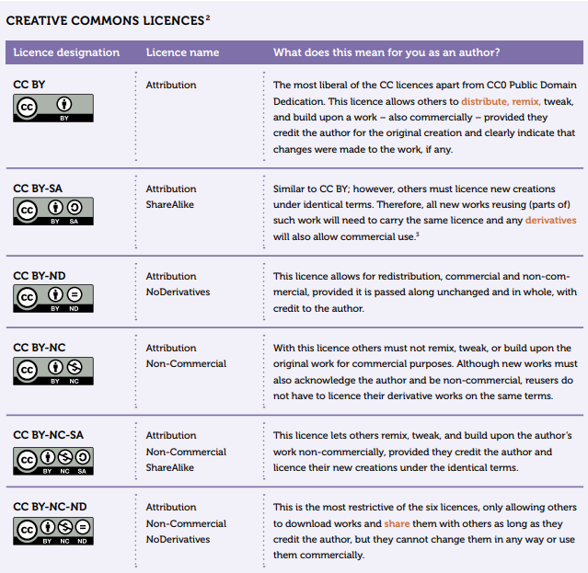
Using music, images, etc in media projects
Creative Commons licenses
Google Images (search by “Tools” and “Usage rights”
Wikimedia Commons
Pixabay (audio and images)
Freemusicarchive.org
Youtube Audio Library (be careful)

